Slide 1
Creating and Modifying Text part 3
Barb Ericson
Georgia Institute of Technology
Oct 2005

Slide 2
Learning Goals
Computing concepts
  What is a dynamic array (ArrayList)?
  Finding the methods of ArrayList and List
  What is an interface?
  Implementing an interface
  Using casting or generics with collections
  Creating students by reading delimited strings from a file

Slide 3
java.util.ArrayList
An ArrayList object is an array that can grow or shrink as needed
  Do we always know how many students can be in a class period?
    If we create an array for more than we have, we waste space
    If we try to add a student past the end of the array
      We get an exception
Use an ArrayList when you don’t know how many of something you need

Slide 4
ArrayList Methods
Look in the Java API for ArrayList
  Open the class java.util
  Click on the class ArrayList
  What methods let you add an object to the ArrayList?
  What method lets you get an object from the ArrayList?
  What method tells you how many things are in the ArrayList?
  What method lets you remove an object from an index in the ArrayList?

Slide 5
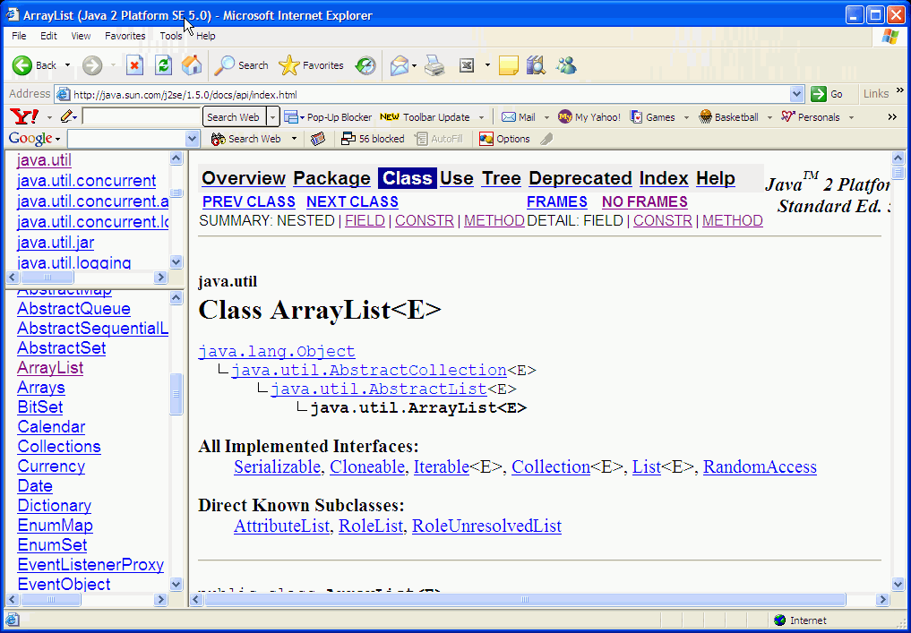
An ArrayList is a List
Look at the API for ArrayList
It implements the List interface
Notes:
When a class implements an interface it can be said to be of the interface type. So since an ArrayList implements the List interface it is a kind of List.

Slide 6
Interfaces
An interface is an abstract class that only has public abstract methods and/or constants
  An abstract method is a method without any code
    like the compareTo method in Comparable
    package java.lang;
    public interface Comparable {
    public int compareTo(Object o);
    }
  Useful for saying what methods a class needs to have
    The class that implements the interface must provide the code for the methods in the interface
    The String class implements the Comparable interface

Slide 7
Exercise
Modify the Student class to implement the Comparable interface
  public class Student implements Comparable
Try to compile it
  It won’t compile till you add the compareTo method
    And provide code for it
  Create a compareTo method to compare the current student to a passed in one
    You can compare the names
      Since the String class implements Comparable

Slide 8
What the compareTo Method Returns
The compareTo method returns an integer
  Negative if the current object is less than the passed object
  0 if they are equal
  Positive if the current object is greater than the passed object
You need to cast from Object to Student
  Before you can compare names
    Student testStudent = (Student) o;

Slide 9
Final compareTo Method
If o is null this will cause a NullPointerException
If o isn’t a Student it will cause a ClassCastException
This will say two students with the same name are equal
  Okay for sorting by name
public int compareTo(Object o)
{
Student testStudent = (Student) o;
return this.name.compareTo(testStudent.name);
}

Slide 10
Decoupling Classes
One of the goals of Object-Oriented Programming
  Is to decouple classes
    Make class A not dependant on class B so that you can change out B for C
  Interfaces let you do this
    Variables can be declared to be the interface type
      List studentList = null;
    Then any class that implements this interface can be used
      studentList = new ArrayList();

Slide 11
Other Interfaces
LEGO bricks have a common interface
  Makes it easy to connect two bricks
  It doesn’t matter what you connect as long as the interface is the same
A USB interface
  Allows you to connect different devices to your computer
    USB drive, camera, etc
    As long as they use the USB interface

Slide 12
ArrayList Exercise
In the ClassPeriod class
  Modify the studentArray to be a studentList
  List studentList = new ArrayList();
Change all the methods that use an array to use a list
  Cast back to Student when you pull the object out of the list
  public Student getStudent(int index)
  {
  return (Student) this.studentList.get(index);
  }

Slide 13
Collections Store Objects
Why do we need to cast the Student object back to Student when we pull it back out of a list?
  A list is a collection of objects
    We need to tell the compiler that it is really a Student object
Or, if we are using Java 1.5 we can use generics
  List<Student> studentList = new ArrayList();
    Then we wouldn’t need to cast to Student
Notes:
Casting from Object to Student is also called downcasting. Going from Student to Object is called upcasting and doesn’t require any casting. Think of this like casting from double to int.

Slide 14
Add a Constructor that takes a File Name
Let’s add a constructor to the ClassPeriod class that takes a file name to read the student information from
public ClassPeriod(String name, int num, String fileName)
{
this.teacherName = name;
this.periodNumber = num;
loadStudentsFromFile(fileName);
}

Slide 15
Create Students from File Exercise
Write the method loadStudentsFromFile(fileName);
  It will be similar to the readAndPrintFile method in SimpleReader
It will loop reading from the specified file
  Until the line that is returned from the reader is null
It will use each line that it reads to create a Student object
  Using the constructor that takes a delimited string
It will add each new student to the studentList

Slide 16
Testing the Method
public static void main(String[] args)
{
ClassPeriod period =
new ClassPeriod("Ms. Clark",5,"student.txt");
// print info about the class period
System.out.println(period);
// print info for each student
for (int i = 0; i < period.studentList.size(); i++)
System.out.println("Student " + i + " is " +
period.getStudent(i));
}

Slide 17
Summary
An ArrayList is an array that can grow or shrink
  Use when you don’t know how many of something you will need
An ArrayList is a List
  Implements the java.util.List interface
An interface is an abstract class
  That only has public abstract methods
  And/or constants
The java.lang.Comparable interface can be implemented by any class
  Used to sort objects in a collection
    By their natural order (defined by class)
The class that implements an interface
  Must provide code for the interface methods

